Slide 1

Topic : Breath – Based Bio Signal Analyzer For Disease Detection
24AIM114 Analog System Design
&
24AIM113 Introduction to NN, CNN and GNN
Team members: Dharshini K. CB.AI.U4AIM24111 Esha R. CB.AI.U4AIM24112 Harsshitha S. CB.AI.U4AIM24115 Vaishnavi P. CB.AI.U4AIM24149
Faculties: Ms. Amrutha V Mrs. Snigdhatanu Acharya
1

Slide 2
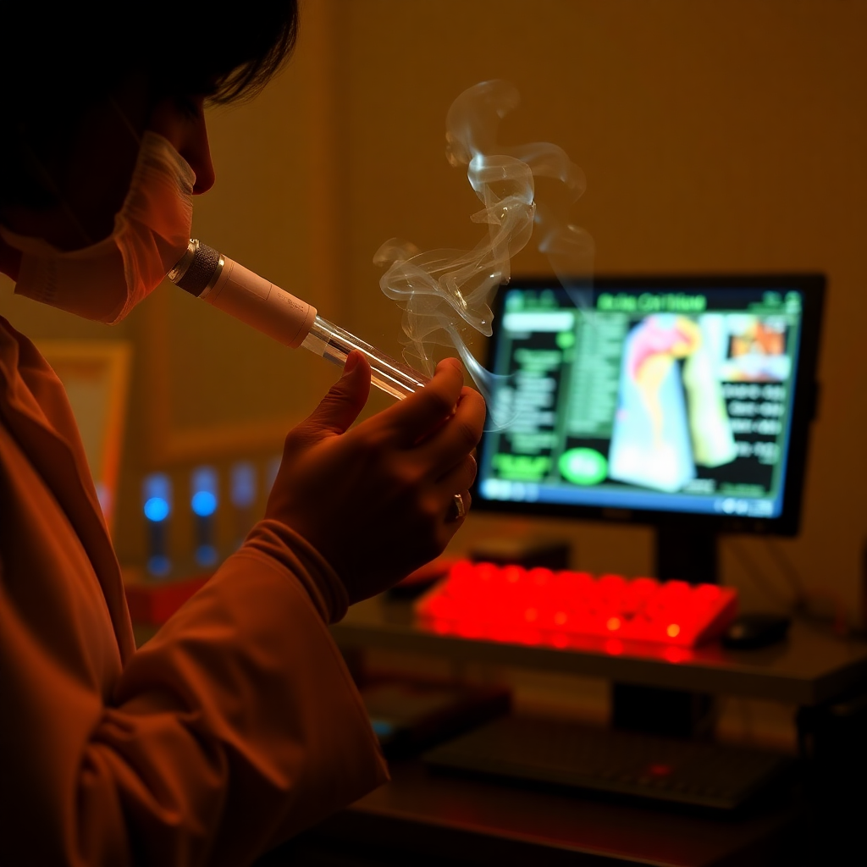
Introduction:
Our project leverages gas sensors (MiCS-5524, TGS 822) and environmental sensors (DHT22) to collect real-time breath data, combined with a Convolutional Neural Network (CNN) trained on a pre-existing UCI dataset. By analyzing patterns in breath composition, the system predicts disease presence with high accuracy.
2

Slide 3
Core Technologies:
Biomedical Sensors for VOC Detection
Detect biomarkers like acetone (diabetes), benzene (lung cancer), and H₂S/methane (GI disorders).
Key Components: MOS sensors(Metal-Oxide-Semiconductor); Arduino/Raspberry Pi for real-time processing.
AI & Machine Learning for Disease Classification
Process: Feature extraction, preprocessing, deep learning models.
Hybrid Approach: Real-time data + pre-existing datasets for high accuracy.
3

Slide 4
Literature Review:
Title | Year | Methodologies | Targeted Disease | Key Contribution
A Low-Cost Device for Measurement of Exhaled Breath for the Detection of Obstructive Lung Disease[1] | 2022 | Hardware Design: Developed the circuit with Arduino UNO and MQ gas sensors and DHT22 Experimental Setup: Data was analysed statistically to determine significant differences between patients and healthy individuals. | Obstructive Lung Disease | Analysis of variance (ANOVA) was performed to compare breath markers.
Detecting Respiratory Diseases Using Machine Learning-Based Pattern Recognition on Spirometry Data[2] | 2024 | Experimental Setup: Pulmonary sound recordings dataset from Kaggle (920 annotated recordings). Data collected from 126 patients of different age groups. | Chronic Obstructive Pulmonary Disorder (COPD) | A hybrid model combining SVM and KNN was used for classification. SVM was used for global decision boundary identification. KNN was used to refine local pattern recognition. Accuracy: 94%
4

Slide 5
Title | Year | Methodologies | Targeted Disease | Key Contribution
Artificial Breath Classification Using XGBoost Algorithm for Diabetes Detection [3] | 2021 | ML Models: Analyze medical data. Feature Selection & Preprocessing: Optimize accuracy. | Diabetes | Results have shown that the designed system based on the XGBoost algorithm was highly selective for acetone, even at low concentrations. Accuracy 99% Specificity 97.9%
DiabeticSense: A Non-Invasive, Multi-Sensor, IoT-Based Pre-Diagnostic System for Diabetes Detection Using Breath [4] | 2023 | Breath Sensors: Detect VOCs for diabetes. Feature Extraction: Ensure calibration, refine data. ML Model: Gradient boosting predicion | Type 2-Diabetes | DiabeticSense Study: Gradient boosting achieved 86.6% accuracy. Outperforms Existing Methods: Higher precision in Type 2- diabetes detection.
5

Slide 6
Title | Year | Methodologies | Targeted Disease | Key Contribution
Non-Invasive Breath Analysis System Using Convolutional Neural Networks for Early Detection of Kidney disease [5] | 2024 | Breath Sampling: Collected breath samples from 181 participants using Tedlar bags and Tenax tubes. Sensor System: Employed a multimodal array of 10 SMO sensors, 1 PID, and 9 EC sensors for VOC detection. Model Implementation: Developed a 1D CNN with six kernels and ReLU activation, utilizing 5-fold cross-validation (80% training, 20% testing). | Kidney disease | Demonstrated the effectiveness of using a multimodal sensor array combined with deep learning techniques for early lung cancer detection Accuracy: 99.8% Sensitivity: 98.9% Specificity: 96.2%
Edge AI-based Respiratory Disease Recognition from Exhaled Breath Signatures [6] | 2021 | Hardware Design: Developed the circuit with STM32 ARM Cortex-M4 and gas sensors TGS 822, MQ-138, MQ-137, TGS 813. Machine Learning: Logistic regression classifier trained on COPD breath datasets. Preprocessing steps to reduce dimensionality and noise. | Chronic Obstructive Pulmonary Disease (COPD) | Portable Offline Kit: Eliminates dependency on cloud connectivity, enabling use in low-resource settings 1. Edge AI Framework: Achieved ultra-low resource usage (15.9 KB ROM, 1.5 KB RAM, 1 ms inference time) 1.
6

Slide 7
Title | Year | Methodologies | Targeted Disease | Key Contribution
Breath Analysis System with Convolutional Neural Network (CNN) for Early Detection of Lung Cancer[7] | 2024 | Breath Sampling: Tedlar bags, Tenax tube adsorption, gas sensor array. Sensor System: Multimodal sensor array (10 SMO, 1 PID, 9 EC sensors). Data Processing: Normalization and time-series CNN model. Model Implementation: 1D CNN with 6 kernels, softmax. Training & Evaluation: 80% training, 20% testing. | Lung cancer. | Achieved 97.8% accuracy, 98.9% sensitivity, and 96.2% specificity for lung cancer detection, demonstrating high reliability.
Exhaled breath analysis in disease detection[8] | 2021 | Breath Sample Analysis: GC-MS (VOC detection), PTR-MS Sensor-Based Detection: Nanoarray sensors (gold nanoparticles, carbon nanotubes), E-Nose (disease pattern recognition). Metabolite & Gas Detection: EBC (metabolic markers), CEAS (ammonia detection for kidney disease). | Lung cancer, Asthma, and Diabetes | Reviewed breath analysis for disease detection and highlighted challenges in standardization, VOC variability, and real-time analysis.
7

Slide 8
Problem Statement:
Invasive Methods: Traditional diagnostic methods for diseases like diabetes, lung cancer, and gastrointestinal disorders are costly and time-consuming.
Non-Invasive Alternative: Breath analysis using VOC biomarkers presents a non-invasive and efficient alternative for disease detection.
Technology Integration: There are very few model that combines gas sensors and deep learning to enable precise, accurate and efficient detection of disease
Hardware Complication: Very few amount of concentration of the VOCs in the breath is neglected, leading to false disease detection.
8

Slide 9
Hardware Components:
Component | Specifications | Working Principle
Arduino Uno (Microcontroller) | Processor: ATmega328P | Reads sensor data and transmits it to Raspberry Pi for further processing.
 | Voltage: 5V
 | Pins: 14 Digital, 6 Analog
Raspberry Pi 4 (Processor) | Processor: Quad-core ARM Cortex-A72 | Handles data processing, runs deep learning model, and controls the dashboard.
 | RAM: 4GB/8GB
 | Ports: USB, HDMI, Ethernet, GPIO
Breath Collection System (Mask & Chamber) | Mask: Collects breath samples | Collects breath samples in a controlled environment, ensuring accurate VOC
 | Chamber: Airtight housing for sensors
9

Slide 10
Component | Specifications | Working Principle
MiCS-5524 (Acetone Sensor) | Type: MOS Sensor | Chemical reaction with acetone alters sensor resistance, generating an analog signal.
 | Range: 1-100 ppm (acetone)
 | Voltage: 5V
 | Output: Analog voltage
TGS-822 (Benzene & H₂S Sensor) | Type: MOS Sensor | Gas reaction with sensor surface changes resistance, producing an analog output.
 | Range: 10-1000 ppb (benzene, H₂S)
 | Voltage: 5V
 | Output: Analog voltage
DHT22 (Temperature & Humidity Sensor) | Type: Digital Sensor | Measures capacitance change in humidity material and temperature using an internal sensor.
 | Range: -40 to +80°C (Temperature), 0-100% RH (Humidity)
 | Voltage: 3.3V-5V
10

Slide 11
Hardware Setup: TGS 822 Sensor:
VCC: Connected to the 5V Pin of the Arduino.
GND: Connected to the GND Pin of the Arduino.
AOUT: Connected to Analog Pin A0 on the Arduino for reading gas concentration.
MiCS 5524 Sensor:
VCC: Connected to the 5V Pin of the Arduino.
GND: Connected to the GND Pin of the Arduino.
AO: Connected to Analog Pin A1 on the Arduino for reading gas concentration.
11

Slide 12
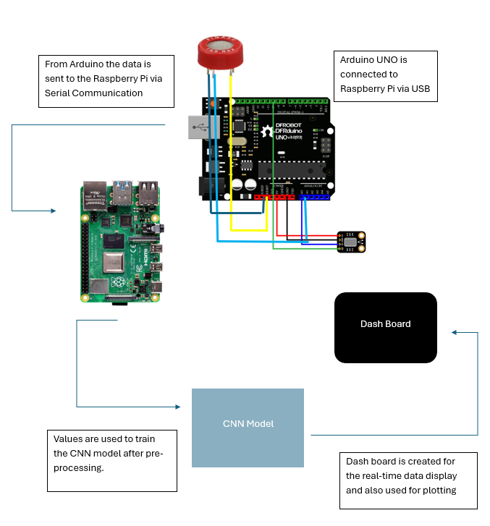
Hardware Connection:
12

Slide 13
CNN Model Working:
Data input and Preprocessing
Load dataset
Model Training
Design the Architecture (Conv1D, MaxPoooling1D, Dense, Dropout layers)
Adam is used for compiler, Loss Function (Binary cross-entropy)
Model Evaluation
Accuracy
Visualize loss and Accuracy curves
Normalize Data: Apply Min-Max Scaling
SMOTE used for handling imbalance datasets
Handle Missing Values: Apply KNN imputation
Optimize (EarlyStopping and ReduceLROnPlateau)
Learning Rate curve
Display final Accuracy
Visualization
Training and Validation Loss
Training and Validation Accuracy
13

Slide 14
Research Gap:
Limited Biomarker Scope :Existing studies focus on a single VOC while ignoring other potential biomarkers.
Small Sample Sizes : Most studies lack large-scale, diverse datasets for better generalization.
Need for Longitudinal Analysis : Existing studies analyze single-time samples instead of tracking disease progression.
Environmental Interference : Breath analysis can be affected by external VOC contamination.
Lack of Standardized Protocols : No universal method for breath sample collection and analysis.
Machine Learning Gaps : Limited use of deep learning; benchmarking against CNNs.
Limited Clinical Validation : Few real-world trials to confirm AI-based breath analysis efficacy.
14

Slide 15
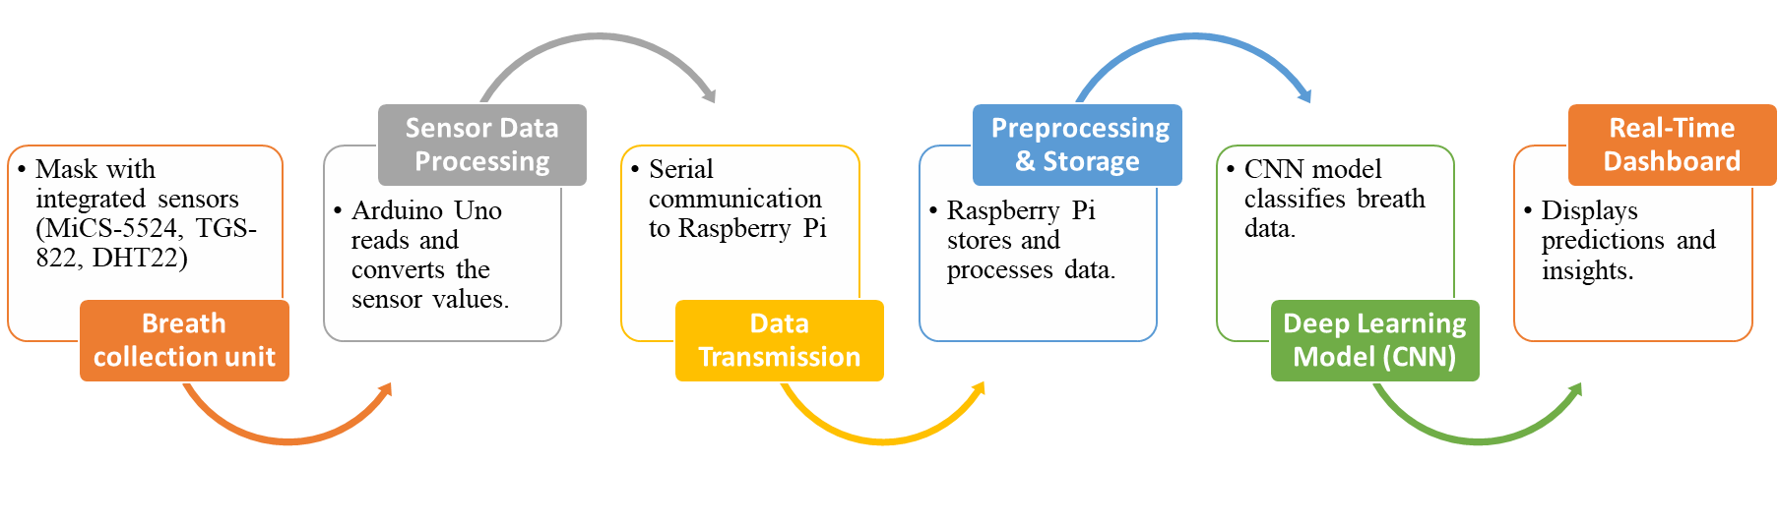
Workflow
15

Slide 16
Timeline:
Literature review, finalizing sensor selection
Weeks 1-2
Hardware setup & sensor calibration
Weeks 3-4
Integration of CNN model with Raspberry Pi
Weeks 9-10
Model training & optimization
Weeks 7-8
Data collection & preprocessing
Weeks 5-6
16

Slide 17
References:
[1]Shahzad, A.A.; Mushtaq, S.; Waris, A.; Gilani, S.O.; Alnuwaiser, M.A.; Jameel, M.; Khan, N.B. A Low-Cost Device for Measurement of Exhaled Breath for the Detection of Obstructive Lung Disease. Biosensors 2022, 12, 409. https://doi.org/10.3390/ bios12060409
[2]Ahmed I. Taloba, R.T. Matoog.Detecting respiratory diseases using machine learning-based pattern recognition on spirometry data, Alexandria Engineering Journal 2025; https://doi.org/10.1016/j.aej.2024.11.009
[3] Paleczek A, Grochala D, Rydosz A. Artificial Breath Classification Using XGBoost Algorithm for Diabetes Detection. Sensors. 2021; 21(12):4187
[4] Kapur, R., Kumar, Y., Sharma, S., Rastogi, V., Sharma, S., Kanwar, V., ... & Dutt, V. (2023). Diabeticsense: A non-invasive, multi-sensor, iot-based pre-diagnostic system for diabetes detection using breath. Journal of Clinical Medicine, 12(20), 6439
[5] Ramji Kalidoss, Snekhalatha Umapathy, Usha Rani Thirunavukkarasu,
A breathalyzer for the assessment of chronic kidney disease patientsâ€™ breathprint: Breath flow dynamic simulation on the measurement chamber and experimental investigation,Biomedical Signal Processing and Control,Volume 70,2021,103060,ISSN 17468094,https://doi.org/10.1016/j.bspc.2021.103060.
[6] Lee B, Lee J, Lee J-O, Hwang Y, Bahn H-K, Park I, Jheon S, Lee D-S. Breath analysis system with convolutional neural network (CNN) for early detection of lung cancer. Sensors and Actuators B: Chemical. 2024;409:135578. doi:10.1016/j.snb.2024.135578.Keywords
[7] Byeongju Lee, Junyeong Lee, Jin-Oh Lee, Yoohwa Hwang, Hyung-Keun Bahn, Inkyu Park, Sanghoon Jheon, Dae-Sik Lee,Breath analysis system with convolutional neural network (CNN) for early detection of lung cancer, Sensors and Actuators B: Chemical,Volume 409,2024,135578,ISSN 0925-4005, https://doi.org/10.1016/j.snb.2024.135578
[8]Ting Chen, Tiannan Liu, Ting Li, Hang Zhao, Qianming Chen,Exhaled breath analysis in disease detection, Clinica Chimica Acta,Volume 515,2021,Pages 61-72,ISSN 0009-8981, https://doi.org/10.1016/j.cca.2020.12.036
17

Slide 18
Thank You!
18

